Slide 1
CSE 2451 Functions
Zichen Zhang

Slide 2
Overview
Functions
Definition
Declaration
Prototype
Passing by value (vs passing by reference)
Function related implicit type casting
Function scope
Function prototype scope
Function call stack
Recursion

Slide 3
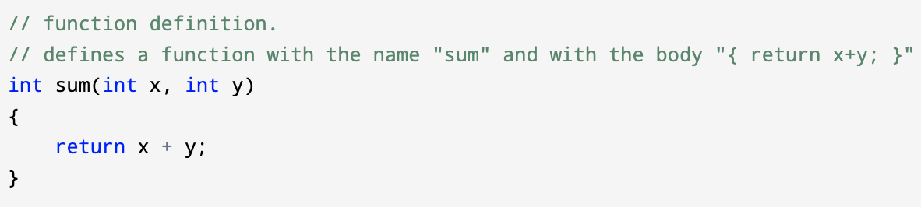
Function
A function is a C language construct that associates
A compound statement (the function body) with
an identifier (the function name)
Every C program begins execution from the main function, which either terminates, or invokes other, user-defined or library functions

Slide 4
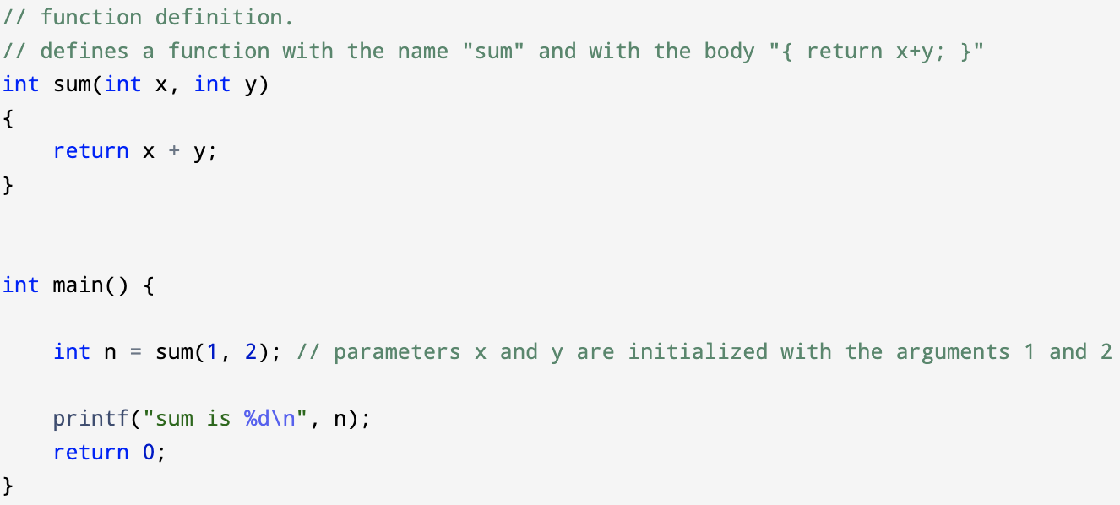
Function
Functions may accept zero or more parameters, which are initialized from the arguments of a function call operator, and may return a value to its caller via the return statement
function call expression:
expression (argument list (optional))
identifier of the function or pointer-to-function, followed by argument list
e.g., sum(1, 2)

Slide 5
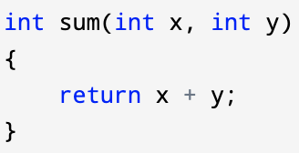
Function - definition
The body of a function is provided in a function definition
Each function used must be defined only once in a program
Function definition are allowed at file scope only, nested functions are prohibited by C standard
function name (identifier)
return type
parameter list
Function definition
function body
return value: C function can return at most one value via its return statement, e.g., “return x, y;” is invalid in C

Slide 6
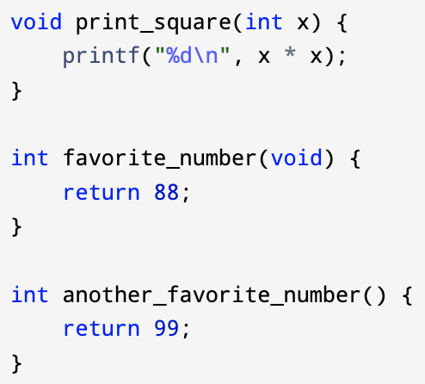
Function - examples
A function that returns nothing (void return type)
A function that accepts no input arguments (void input)
A function that accepts arbitrary number of input arguments, and ignores them all (empty parameter list)

Slide 7
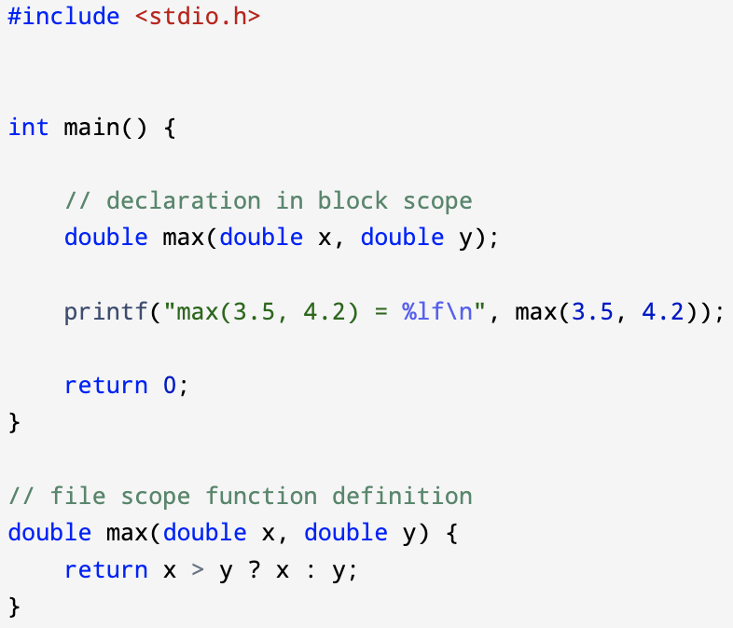
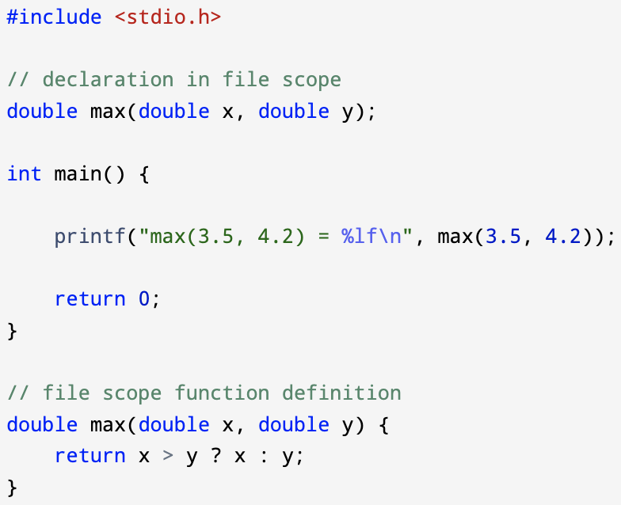
Function - declaration
A function declaration introduces an identifier (function name) that designates a function and, optionally, specifies the types of the function parameters (the prototype) -> it changes visibility of the function
Block scope
file scope
Notes:
Declaration vs prototype:
https://stackoverflow.com/questions/43781565/declaration-and-prototype-difference#:~:text=A%20function%20declaration%20is%20any,of%20the%20parameters%20are%20specified.

Slide 8
Function – definition vs declaration
Definition
Return type
Function name (identifier)
Parameter list
Function body
Must be file scope
Declaration
Return type
Function name (identifier)
Parameter list (optional)
Can be either file scope or block scope
declaration
definition

Slide 9
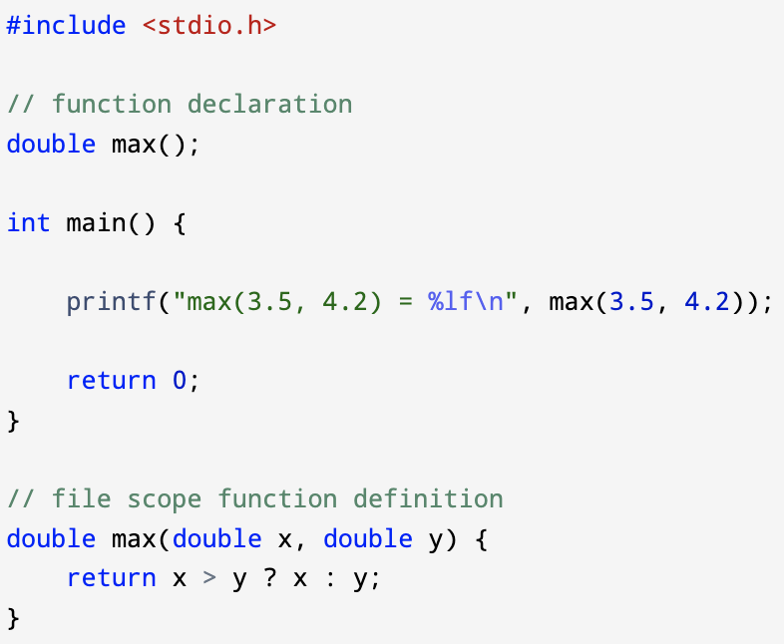
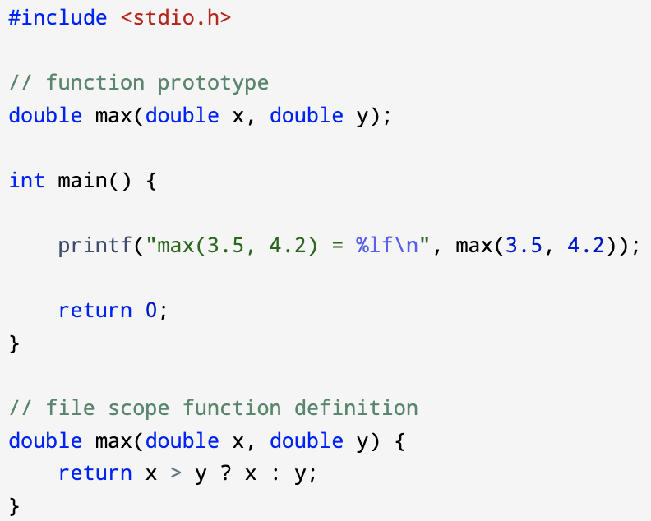

Function – declaration vs prototype
function prototype $⊂$ function declaration
If a function declaration specifies the types of function parameters, then it is a function prototype, otherwise it’s only a function declaration
Function
declaration
Function
prototype

Slide 10
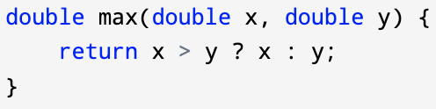
Function – valid function declarations
Function declarations can have the following 3 forms
return-type function-name (); // doesn’t include parameter lists
return-type function-name (param-list); // list of parameter types
return-type function-name (param-list); // list of parameter types and names
Example declaration of the max function:
double max(); // not a prototype
double max(double, double); // a prototype, name of parameters optional
double max(double a, double b); // a prototype

Slide 11
Function – formal parameters vs actual inputs
Formal parameters: parameters in the parameter list of function definition
Actual inputs: values passed to the function via function call as its inputs
Function call: passing values of input arguments to function’s formal parameters in its parameter list via assignment
Actual inputs
Formal parameters

Slide 12
Function - passing by value
Function in C uses passing by value:
Values of actual inputs in caller are copied to formal parameters of callee
Changes made to formal parameters in callee stay in the callee’s scope (function scope), not visible to the caller
Pointers can be used to bypass this limit
Passing by reference:
reference to a variable is an alias of the variable (both referring to the same memory storage location)
Change made to reference transcend outside the callee function, visible to the caller
E.g., C++ allow each type to be passed by either reference or value
Other languages (Python, Java, etc) do something more complicated: primitive types are passed by value and class types are passed by reference
Notes:
Source:
https://stackoverflow.com/questions/373419/whats-the-difference-between-passing-by-reference-vs-passing-by-value

Slide 13
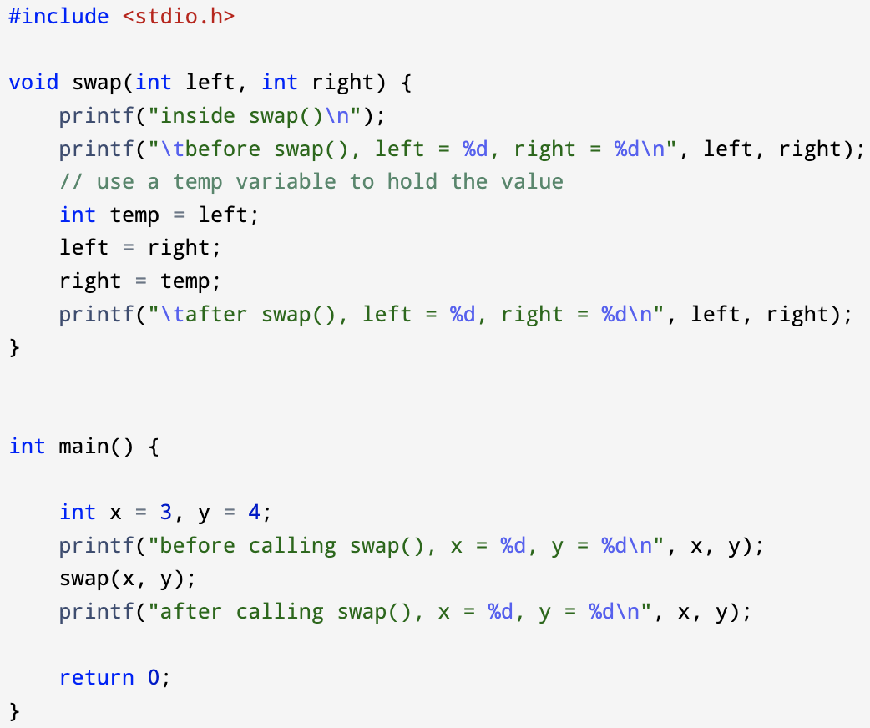
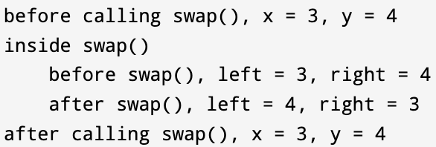
Function - examples
swap function, tries to swap the values of its actual inputs by swapping the values of its formal parameters (won’t work)
Caller: main() function
Actual inputs:
x = 3
y = 4
Callee: swap() function
Formal parameters:
left = x
right = y

Slide 14
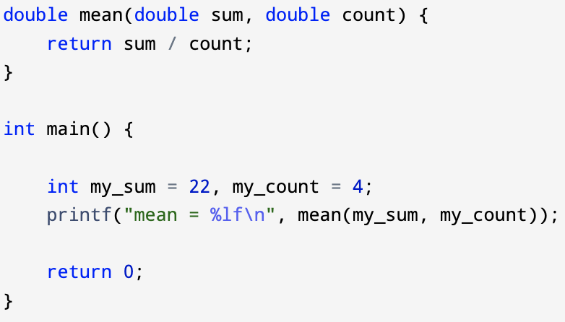

Function – implicit type casting
Types of actual input arguments passed to a function are implicitly converted to types of the formal parameters specified by function definition
Formal parameters have double types
Actual input arguments have int types
22, and 4 are implicitly casted to 22.0, and 4.0 when assigning their value to sum and count

Slide 15
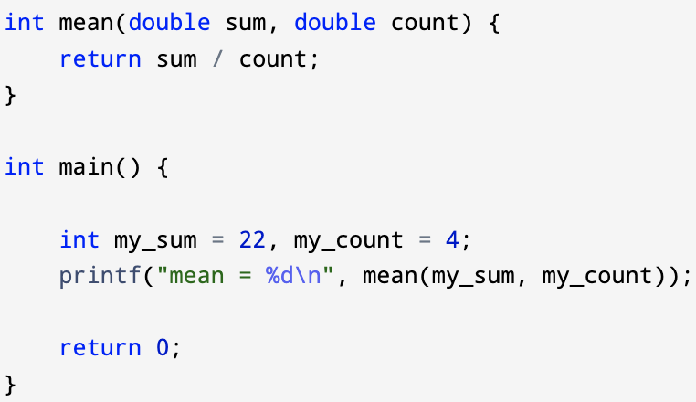

Function – implicit type casting
The type of the function’s return value will be implicitly casted to the type specified by the function definition
Implicit type casting occurred on input values (int → double)
Implicit type casting occurred on return value (double → int)

Slide 16
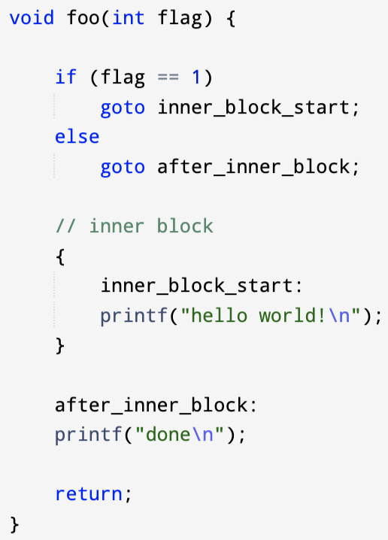
Function scope
Function scope is almost the same as block scope (the block being the function body)
One exception: label of goto statement inside a function is visible in the entire function body whether it’s in the outer block (function body block) or it’s in some inner block inside the function body
Formal parameters of a function has function scope, they are “in scope” (visible) across the entire function body
Notes:
https://en.cppreference.com/w/c/language/scope

Slide 17
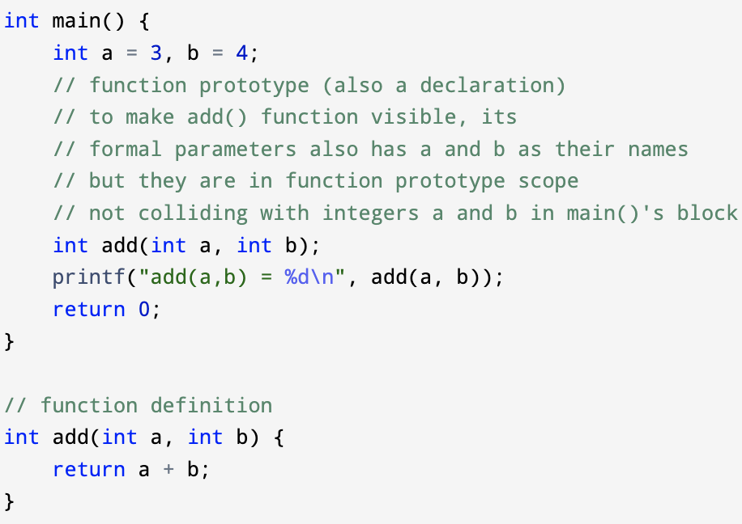
Function prototype scope
The scope of a name introduced in the parameter list of a function declaration that is not a definition ends at the end of the function declarator
Function prototype can be put into file scope, block scope, function scope to make the associated function visible in the respective scope
This creates cases where other “in scope” objects may have the same name with the name of formal parameters in the function prototype
The outer scope names will be hidden in the function prototype scope when they share same names with formal parameters

Slide 18
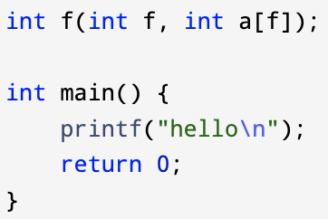
Function prototype scope - example
function prototype scope
Parameter f, and array a[f] in function prototype scope
In function prototype scope, the function name f from file scope is hidden, formal parameter f is used to form its second parameter a[f]
Function name f in file scope
Notes:
Clockwise spiral rule:
https://c-faq.com/decl/spiral.anderson.html
https://stackoverflow.com/questions/20869807/get-confused-with-this-declaration-int-foodouble3
Scope starts right after the finish of a declarator:
https://stackoverflow.com/questions/73808209/point-of-declaration-within-function-prototype-scope-in-c

Slide 19
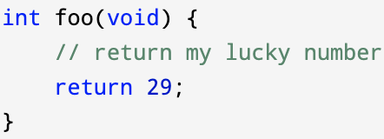
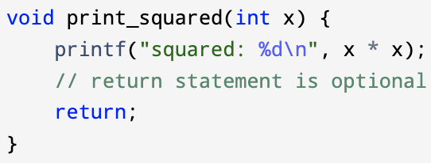
Function – void examples
Function with no input: use void in its parameter list
Function with no return: use void in return type

Slide 20
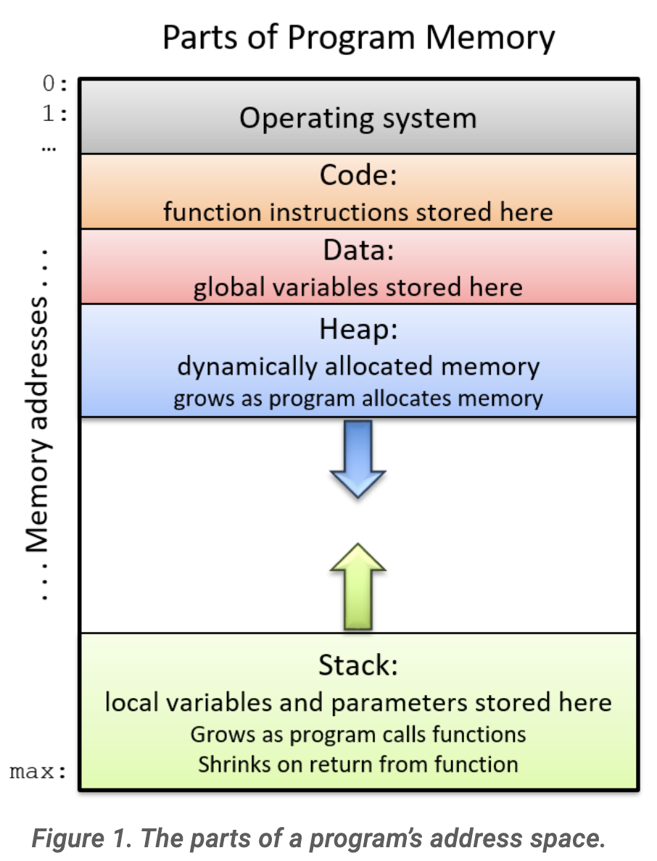
Function – Function call stack
Function call stack
Also referred as the stack, call stack, execution stack, or machine stack
Call stack is a dynamic data structure maintained inside the RAM memory by the Operating System
Primary task of Function Call Stack in C is to manage the function calls and how they pass parameters to each other
Stack frame
Each function call creates a new stack frame
Contains the function call’s parameter and local variable values
The stack frame on top of the call stack is called active frame or activate record, representing the function that’s currently executing
When a function returns, its stack frame (active frame) is popped out of the stack, leaving its caller’s frame on top of the call stack (becomes the new active frame)
Image source: Suzanne J. Matthews, Tia Newhall, Kevin C. Webb, ”Dive into Systems”
Notes:
Stack frame clear explanation:
https://stackoverflow.com/a/10057535/7570599
Call stack example at 26:05
https://www.youtube.com/watch?v=03pp6cz8lWo
Data segment size:
https://en.wikipedia.org/wiki/Data_segment

Slide 21
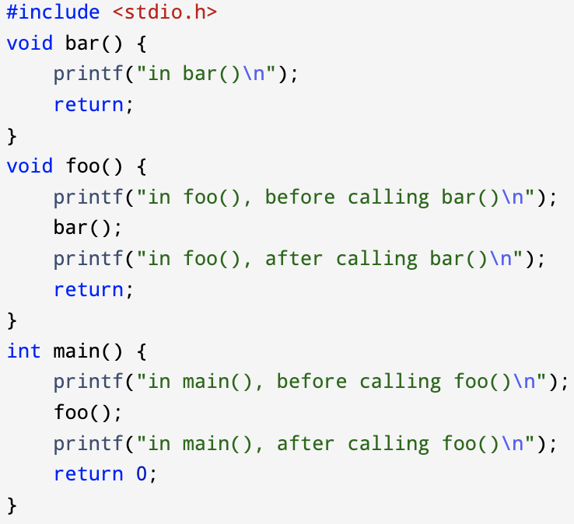
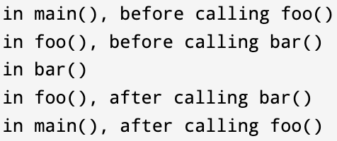
Function – call stack example
Main function also has its stack frame
Notes:
Stack overflow vs segmentation fault:
https://stackoverflow.com/questions/2685413/what-is-the-difference-between-a-segmentation-fault-and-a-stack-overflow

Slide 22
Function – call stack example
Note: visualization of printf() stack frames are omitted in the following slides
Main function also has its stack frame
Function call stack
push
pop
Standard output:
Current step: before entering main()
Notes:
Stack overflow vs segmentation fault:
https://stackoverflow.com/questions/2685413/what-is-the-difference-between-a-segmentation-fault-and-a-stack-overflow

Slide 23
Function – call stack example
Main function also has its stack frame
Function call stack
push
pop
Standard output:
Current step
Stack frame for main()
Notes:
Stack overflow vs segmentation fault:
https://stackoverflow.com/questions/2685413/what-is-the-difference-between-a-segmentation-fault-and-a-stack-overflow

Slide 24
Function – call stack example
Main function also has its stack frame
Function call stack
push
pop
Standard output:
in main(), before calling foo()
Current step
Stack frame for main()
Notes:
Stack overflow vs segmentation fault:
https://stackoverflow.com/questions/2685413/what-is-the-difference-between-a-segmentation-fault-and-a-stack-overflow

Slide 25
Function – call stack example
Main function also has its stack frame
Function call stack
push
pop
Standard output:
in main(), before calling foo()
Current step
Stack frame for foo()
Stack frame for main()
Notes:
Stack overflow vs segmentation fault:
https://stackoverflow.com/questions/2685413/what-is-the-difference-between-a-segmentation-fault-and-a-stack-overflow

Slide 26
Function – call stack example
Main function also has its stack frame
Function call stack
push
pop
Current step
Standard output:
in main(), before calling foo()
in foo(), before calling bar()
Stack frame for foo()
Stack frame for main()
Notes:
Stack overflow vs segmentation fault:
https://stackoverflow.com/questions/2685413/what-is-the-difference-between-a-segmentation-fault-and-a-stack-overflow

Slide 27
Function – call stack example
Main function also has its stack frame
Function call stack
push
pop
Current step
Standard output:
in main(), before calling foo()
in foo(), before calling bar()
Stack frame for bar()
Stack frame for foo()
Stack frame for main()
Notes:
Stack overflow vs segmentation fault:
https://stackoverflow.com/questions/2685413/what-is-the-difference-between-a-segmentation-fault-and-a-stack-overflow

Slide 28
Function – call stack example
Main function also has its stack frame
Function call stack
push
pop
Current step
Standard output:
in main(), before calling foo()
in foo(), before calling bar()
in bar()
Stack frame for bar()
Stack frame for foo()
Stack frame for main()
Notes:
Stack overflow vs segmentation fault:
https://stackoverflow.com/questions/2685413/what-is-the-difference-between-a-segmentation-fault-and-a-stack-overflow

Slide 29
Function – call stack example
Main function also has its stack frame
Function call stack
push
pop
Current step
Standard output:
in main(), before calling foo()
in foo(), before calling bar()
in bar()
Stack frame for foo()
Stack frame for main()
Notes:
Stack overflow vs segmentation fault:
https://stackoverflow.com/questions/2685413/what-is-the-difference-between-a-segmentation-fault-and-a-stack-overflow

Slide 30
Function – call stack example
Main function also has its stack frame
Function call stack
push
pop
Current step
Standard output:
in main(), before calling foo()
in foo(), before calling bar()
in bar()
in foo(), after calling bar()
Stack frame for foo()
Stack frame for main()
Notes:
Stack overflow vs segmentation fault:
https://stackoverflow.com/questions/2685413/what-is-the-difference-between-a-segmentation-fault-and-a-stack-overflow

Slide 31
Function – call stack example
Main function also has its stack frame
Function call stack
push
pop
Current step
Standard output:
in main(), before calling foo()
in foo(), before calling bar()
in bar()
in foo(), after calling bar()
Stack frame for main()
Notes:
Stack overflow vs segmentation fault:
https://stackoverflow.com/questions/2685413/what-is-the-difference-between-a-segmentation-fault-and-a-stack-overflow

Slide 32
Function – call stack example
Main function also has its stack frame
Function call stack
push
pop
Standard output:
in main(), before calling foo()
in foo(), before calling bar()
in bar()
in foo(), after calling bar()
in main(), after calling foo()
Current step
Stack frame for main()
Notes:
Stack overflow vs segmentation fault:
https://stackoverflow.com/questions/2685413/what-is-the-difference-between-a-segmentation-fault-and-a-stack-overflow

Slide 33
Function – call stack example
Main function also has its stack frame
Function call stack
push
pop
Standard output:
in main(), before calling foo()
in foo(), before calling bar()
in bar()
in foo(), after calling bar()
in main(), after calling foo()
Current step
Notes:
Stack overflow vs segmentation fault:
https://stackoverflow.com/questions/2685413/what-is-the-difference-between-a-segmentation-fault-and-a-stack-overflow

Slide 34
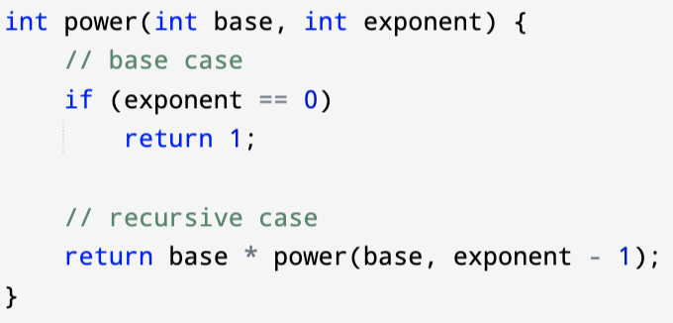
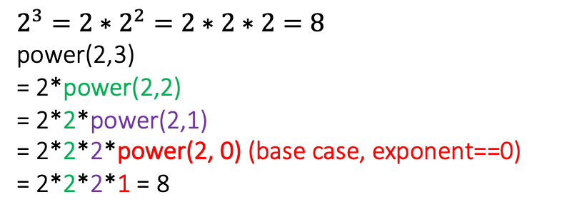
Function - recursion
Inside the function body, it make function call(s) to itself
Typically consists of
Base case
Make no more function call to itself and return to its caller
Recursive case
statement that makes new a function call to itself
$$2^{3}=2∗2^{2}=2∗2∗2=8$$
power(2,3)
= 2*power(2,2)
= 2*2*power(2,1)
= 2*2*2*power(2, 0) (base case, exponent==0)
= 2*2*2*1 = 8
Notes:
Function call stack
https://www.scaler.com/topics/c/c-function-call-stack/
https://cs.gmu.edu/~kauffman/cs222/stack-demo.html
Stack frame:
https://stackoverflow.com/a/10057692/7570599
https://www.geeksforgeeks.org/stack-frame-in-computer-organization/
https://stackoverflow.com/a/40106523/7570599

Slide 35
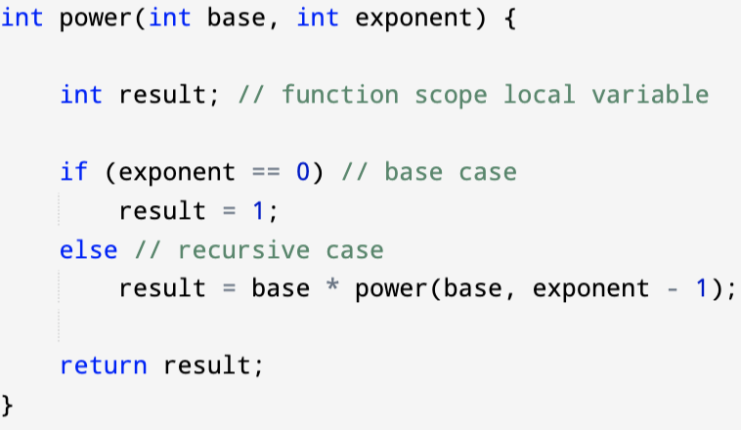
Function – Recursion examples
Note: stack frame for caller of power(3,3), i.e., the main function is omitted
Each function call creates its own stack frame, recording local variable values
Recursive calls of the same function creates multiple stack frames corresponding to each function call
Call stack
Base case
result = 1
base = 3
exponent = 0
Power(3,0)
result = ?
base = 3
exponent = 1
Power(3,1)
result = ?
base = 3
exponent = 2
Power(3,2)
Power(3,3)
result = ?
base = 3
exponent = 3
First call

Slide 36
Function – Recursion examples
Each function call creates its own stack frame, recording local variable values
Recursive calls of the same function creates multiple stack frames corresponding to each function call
Call stack
Base case
Power(3,0)
result = 3
base = 3
exponent = 1
return 1
Power(3,1)
result = ?
base = 3
exponent = 2
Power(3,2)
Power(3,3)
result = ?
base = 3
exponent = 3
First call

Slide 37
Function – Recursion examples
Each function call creates its own stack frame, recording local variable values
Recursive calls of the same function creates multiple stack frames corresponding to each function call
Call stack
Base case
Power(3,0)
return 1
Power(3,1)
return 3
result = 9
base = 3
exponent = 2
Power(3,2)
Power(3,3)
result = ?
base = 3
exponent = 3
First call

Slide 38
Function – Recursion examples
Each function call creates its own stack frame, recording local variable values
Recursive calls of the same function creates multiple stack frames corresponding to each function call
Call stack
Base case
Power(3,0)
return 1
Power(3,1)
return 3
Power(3,2)
return 9
Power(3,3)
result = 27
base = 3
exponent = 3
First call

Slide 39
Function – Recursion examples
Each function call creates its own stack frame, recording local variable values
Recursive calls of the same function creates multiple stack frames corresponding to each function call
Call stack
Base case
Power(3,0)
return 1
Power(3,1)
return 3
Power(3,2)
return 9
Power(3,3)
First call
return 27

Slide 40
Function – Variadic functions
Variadic functions are functions which take a variable number of arguments
E.g., printf() function
printf(“Hi\n”);
printf(“Hi %d\n”, 3);
printf(“Hi %d %d\n”, 3, 4);
E.g., scanf() function extracting varying number of user input from stdin
C supports customized variadic function
Need #include <stdarg.h>
Notes:
Resource: https://www.unf.edu/~cwinton/html/cop3601/s10/class.notes/C6-ellipsis.pdf

